Slide 1


Name: ABDULGHANI
Date: 7/15/2022
Github Repo:

Slide 2

Outline
Executive Summary
Introduction
Methodology
Results
Conclusion

Slide 3
Executive Summary
Collecting data from SpaceX API with Python, creating tables and columns for the successful landing, and exploring and visualize the data using SQL sci-learn and Pandas, and perform statistic operations on the data, and use Machine learning model to get the best predictions results.
We will use Machine Learning Models for predicting better result like Logistic regression, Support Victor Machine, Destino Tree and K Nerats Nigbor, all these models able to predicts successful landing with accuracy up to 85%, if we add more data we can get more accurate results.

Slide 4
ii. Introduction
SpaceX is an American space craft manufacture, space launch provider, and a satellite communications, corporation headquartered in Hawthorne, California, SpaceX was founded in 2002 by Elon Musk.
SpaceX has best pricing ($62 Millions VS. $165 Millions)
SpacY is another competitive company against SpaceX.
The Problem: SpaceY tasked to train a Machine Learning Model to Predict the Accuracy Percentage of Successful landing.

Slide 5

Section 1

Slide 6
iii. Methodology
Executive Summary
Data collection methodology:
Collecting Data From SpaceX API, and Wikipedia website using Python
Perform data wrangling
Trying to predicts the landing was successful or not
Perform exploratory data analysis (EDA) using visualization and SQL
Perform interactive visual analytics using Folium and Plotly Dash
Perform predictive analysis using classification models
Run models using GridSearchCV

Slide 7
Data Collection
We have to main method to collection the data
SpaceX API: Provide us with a different data consisted of rows and columns (FlightNumber, BoosterVersion, Date, PayloadMass, Orbit, LaunchSite, Outcome, Flight, GridFins, Reused, Legs, LandingPad, Block, ReusedCount, Serail, Longitude, Latitude).
Wikipedia (web scraping): we can extract the data from wikipedia using Beatifulsoup Python package which contained (Flight No, Launch Site, Payload, PayloadMass, Orbit, Customer, Launch outcome, Version Booster, Booster landing, Date, Time).

Slide 8
Data Collection – SpaceX API
Request(SpaceX API)
Json File List
Normalize to Data Frame
Filter The Data to include Falcon9 only.
Remove the missing value.
Present your data collection with SpaceX REST calls using key phrases and flowcharts
GitHub: https://github.com/abdulghani91/Applied-Data-Science-Capstone/blob/master/Week_1_Introduction/1-jupter-lab-Falcon9.ipynb

Slide 9
Data Collection - Scraping
Request(Wikipedia.html)
Use BS4 to Extract Data
Soup.find_all('table')
Create dict and extract the Data from it
Filtering and convert the dict to DF
Present your web scraping process using key phrases and flowcharts
GitHub URL: https://github.com/abdulghani91/Applied-Data-Science-Capstone/blob/master/Week_1_Introduction/jupyter-labs-webscraping.ipynb

Slide 10
Data Wrangling
We have two type of labels successful landing = 1, and unsuccessful=0, in the column Mission outcome.
We add another two columns 'class' equal 1 if the mission outcome is successful, and 0 if it is unsuccessful, and another column color depend on the class column is the class =1 the color= Green, else 0 the color= Red.
GitHub URL: https://github.com/abdulghani91/Applied-Data-Science-Capstone/blob/master/Week_1_Introduction/labs-jupyter-spacex-Data%20wrangling.ipynb

Slide 11
EDA with Data Visualization
We plot Flight Number Vs. PayloadMass, Flight Number Vs. Launch Site, Orbit Vs Success Rate, Flight Number Vs. Orbit, Payload Vs. Orbit, and Success Yearly trends.
We used scatter plots, line charts, and bar charts to see the relationship between variables, if there is any connection between any two variables they could be useful for building the model.
GitHub URL: https://github.com/abdulghani91/Applied-Data-Science-Capstone/blob/master/Week_2_Exploratory_Data_Analysis_Using_SQL/jupyter-labs-eda-dataviz.ipynb

Slide 12
EDA with SQL
We used SQL to analyze our data, by including the magic variable % we can use SQL queries with python.
We review the dataset with select and other SQL queries.
We could filter our data using where query and other useful SQL queries.
GitHub URL: https://github.com/abdulghani91/Applied-Data-Science-Capstone/blob/master/Week_2_Exploratory_Data_Analysis_Using_SQL/jupyter-labs-eda-sql-coursera_sqllite.ipynb

Slide 13
Build an Interactive Map with Folium
Folium is a Python package that makes it easy for you to display any map for any country or region, and we use it to display the launching site on the map by using the latitude and longitude of the lunching site
By reviewing the launching site on the map we will able to see where is the location of each site and how long the distance between each of them.
GitHub URL: https://github.com/abdulghani91/Applied-Data-Science-Capstone/blob/master/Week_3_Interactive_Visual_Analytics_and_Dashboards/lab_jupyter_launch_site_location.ipynb

Slide 14
Build a Dashboard with Plotly Dash
Plotly Dash is another Python tool that let us display our data on a dashboard but this kind of live dashboard means you can select the data of any year from the dropdown menu and will show you the result directly, and you can specify the payload Mass KG for any range like between 5000-13000 KG it will show you the data related with the specific value of KG and the specific year, this is will help us to see how many success lunching for every year.
GitHub URL of your completed Plotly Dash lab: https://github.com/abdulghani91/Applied-Data-Science-Capstone/blob/master/Week_3_Interactive_Visual_Analytics_and_Dashboards/spacex_dash_app.py

Slide 15
Predictive Analysis (Classification)
Splite (train, test)
Transform and Fit the Features
Train the Splited Data
Get The Score(Test Data)
Use (KNN,SVM,DT,LR) models for prediction
GridSearchCV(cv=10) to Find the optimal parameter
Print the Confusion Matrix
Compare the Models for best performance
Summarize how you built, evaluated, improved, and found the best performing classification model
You need present your model development process using key phrases and a flowchart.
GitHub URL of predictive analysis lab: https://github.com/abdulghani91/Applied-Data-Science-Capstone/blob/master/Week_4_Predictive_Analysis_Overview/SpaceX_Machine%20Learning%20Prediction_Part_5.ipynb

Slide 16
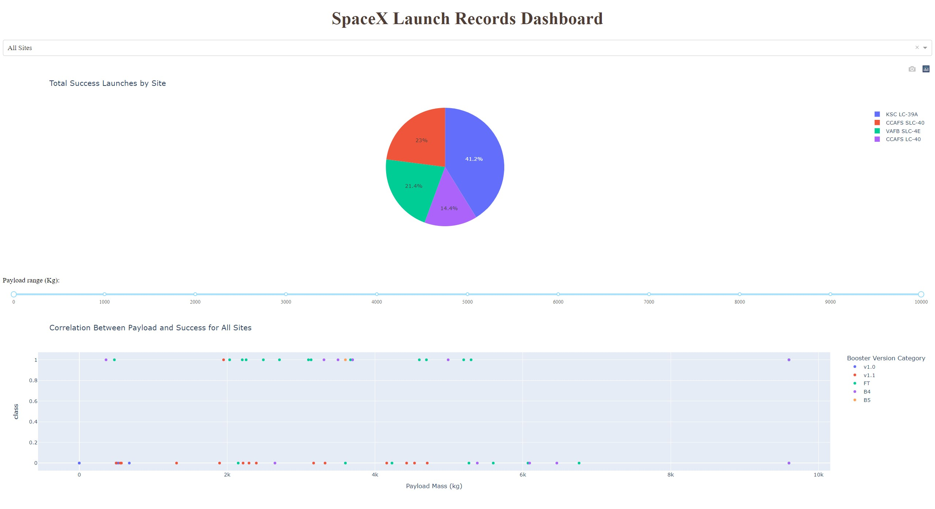
Results
This is a Plotly Dashboard show the result of EDA with visualization, EDA with SQL, Interactive Map with Folium and the result of our models

Slide 17

Section 2

Slide 18
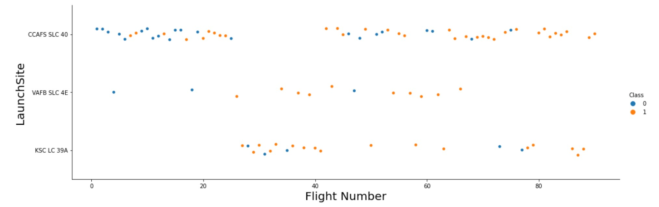
Flight Number vs. Launch Site
This is a scatter plot the Blue dots indicates successful launching and the orang indicate failed

Slide 19
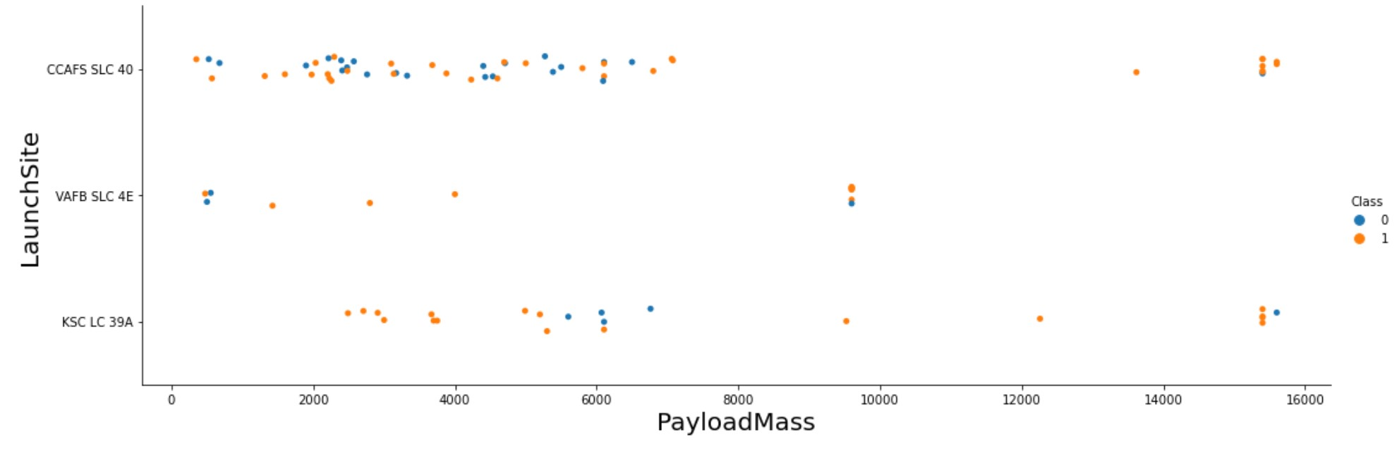
Payload vs. Launch Site
This is a scatter plot the Blue dots indicates successful launching and the orang indicate failed
This graph show that almost 75% of the launching was for payloadmass between 0-8000

Slide 20
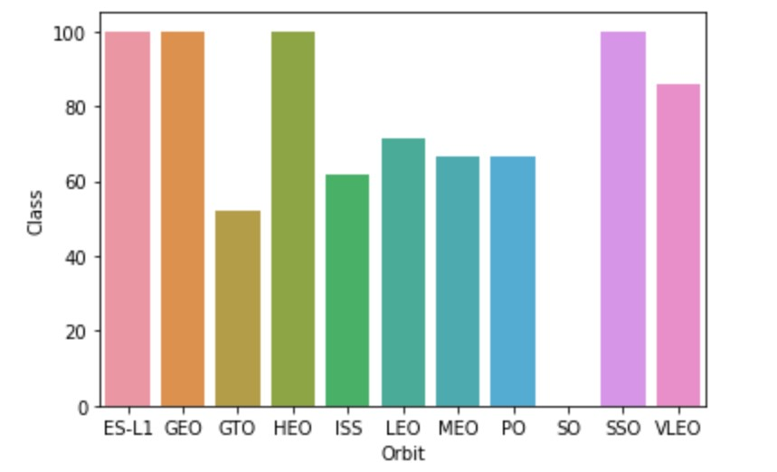
Success Rate vs. Orbit Type
ES-L1, GEO, HEO, SSO have a successful rate of 100%.
GTO have a successful rate of 50%.
ISS have a successful rate of 60%.
LEO have a successful rate of 70%.
MEO, PO have a successful rate of 65%.
VLEO have a successful rate of 90%.

Slide 21
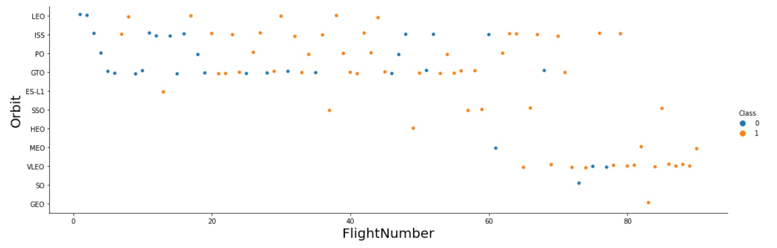
Flight Number vs. Orbit Type
This is a scatter plot the Blue dots indicates successful launching and the orang indicate failed
We can see that from flight number 0 to 60 the Flight done using orbit type LEO, ISS, PO, GTO
And from 60 to the last one for the others.

Slide 22
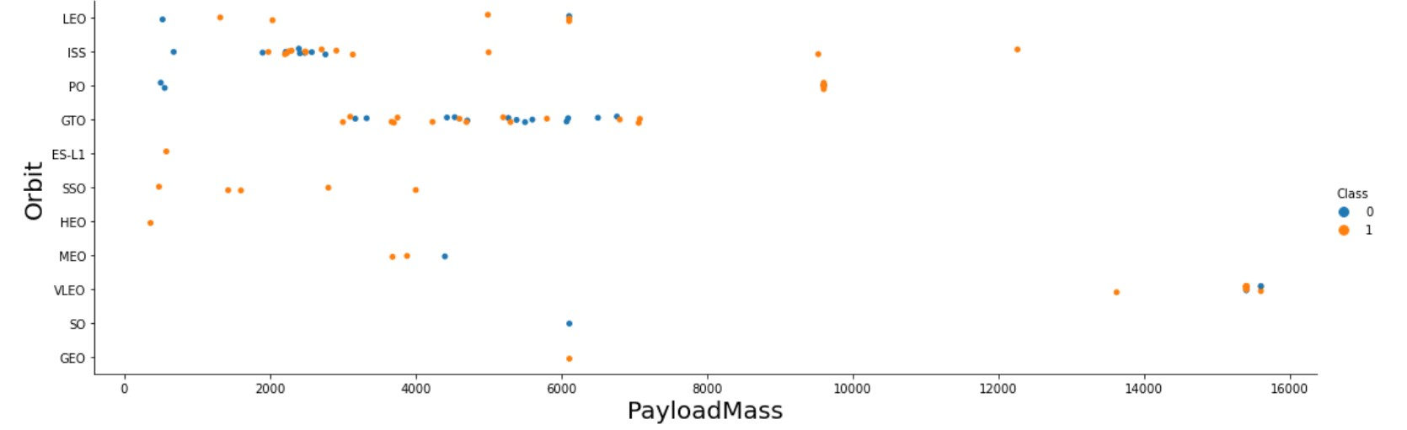
Payload vs. Orbit Type
This is a scatter plot the Blue dots indicate successful launching and the orang indicates failed
LEO, and ISS seem to have the most load from 0 to 3500 KG.
GTO has the most load from 3500 to 8000.
LEO, ISS GTO has a total of 75% of all the orbit types.

Slide 23
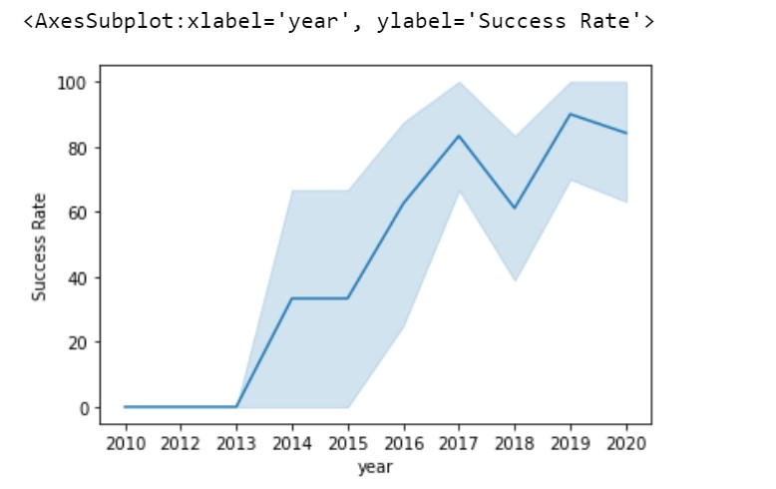
Launch Success Yearly Trend
The chart indicates the increase in yearly success.
The blue line indicates the increase in yearly success.
The success rate star at 0 in the year 2010 and in 2013 started increasing until 2020.

Slide 24
EDA with SQL
EXPLORATORY DATA ANALYSIS WITH SQL DB2
INTEGRATED IN PYTHON WITH SQLALCHEMY

Slide 25
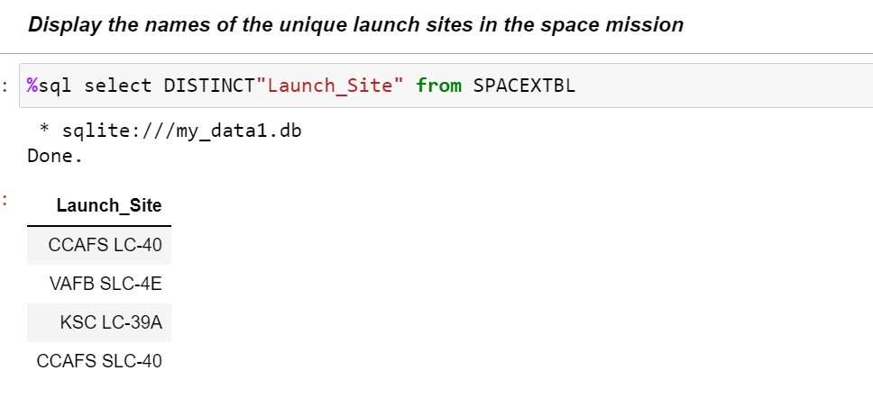
All Launch Site Names
The names of Lancing Site: CCAFS LC-40, VAFB SLC-4E, KSC LC-39A, CCAFS SLC-40.
Using the Distinct query we will have a unique result without duplicated items.
We use Distinct with the Lunch_site to get the name of every launching site.

Slide 26
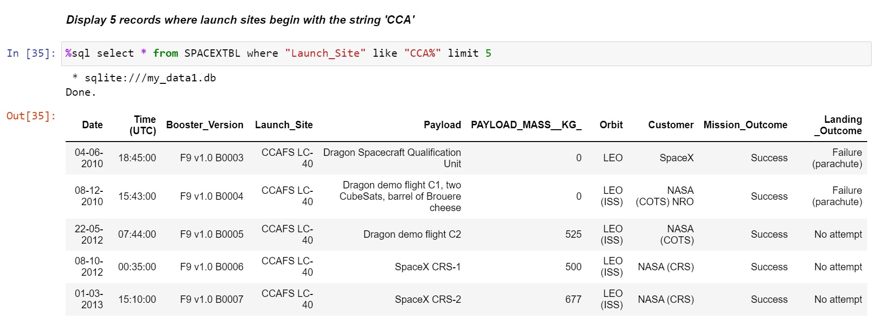
Launch Site Names Begin with 'CCA'
We used select to view the result and we specify the content using where and like.
We use ‘CCA%’ in the like clause to specify we want to view any record start with CCA.

Slide 27
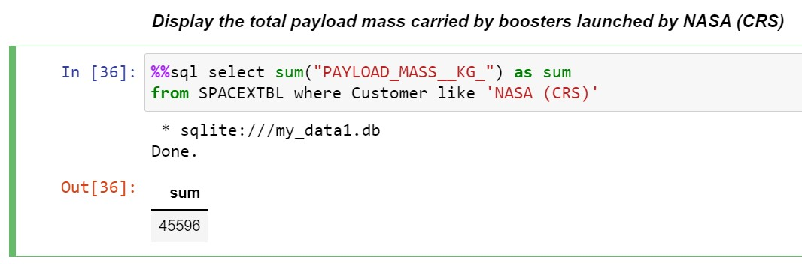
Total Payload Mass
We used the sum function which is a special SQL function to give us the summation of a specific column.
We used sum function to sum all the values in PAYLOAD_MASS_KG columns if any values in customer columns = ‘NASA (CRS)’.
The summation result was 45596.

Slide 28
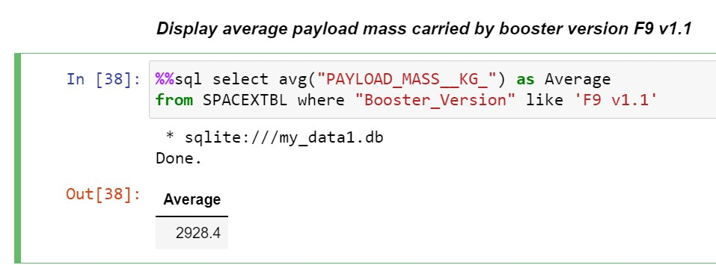
Average Payload Mass by F9 v1.1
We used AVG SQL special function to calculate the average of PAYLOAD_MASS_KG, for every Booster_Version equal to ‘F9 v1.1’.
The Average value is stored in the new table named Average.
The value of calculating the Average was 2928.4.

Slide 29
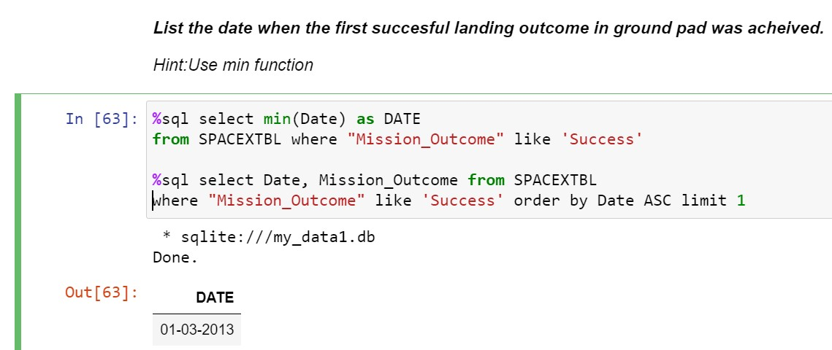
First Successful Ground Landing Date
We use select to view the first successful landing, by specifying the value of column Mission_Outcome equal to Success.
We used two different ways the first one with the min() function which gives us the mini value of the date, and the second one with the order by Ascending and limiting the result to 1.
The date of the first successful landing on 01-03-2013.

Slide 30
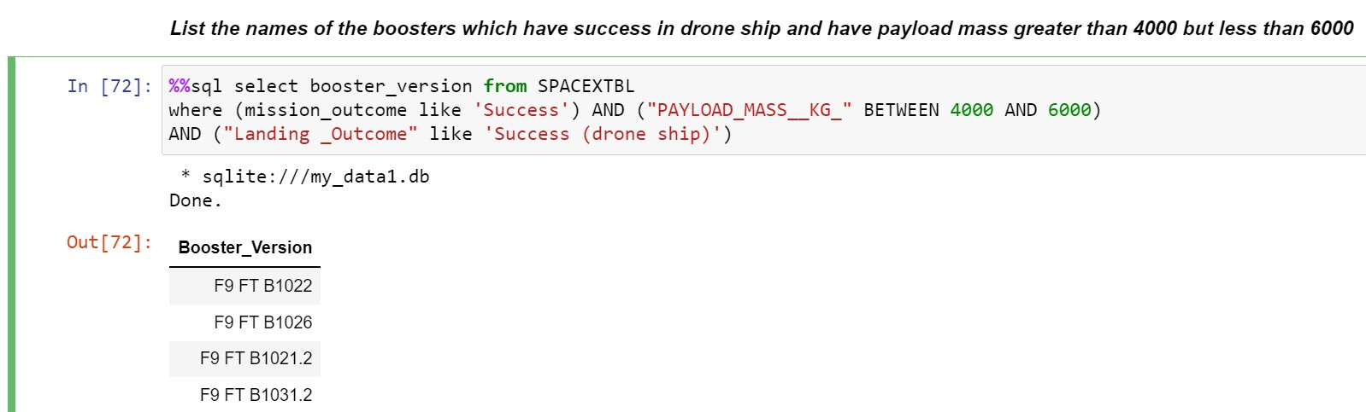
Successful Drone Ship Landing with Payload between 4000 and 6000
the names of boosters (4000-6000): F9FTB1022, F9FTB1026, F9FTB10212, F9B10312.
We used multiple conditions in where clause using AND, and like for specifying the values of the different columns.

Slide 31
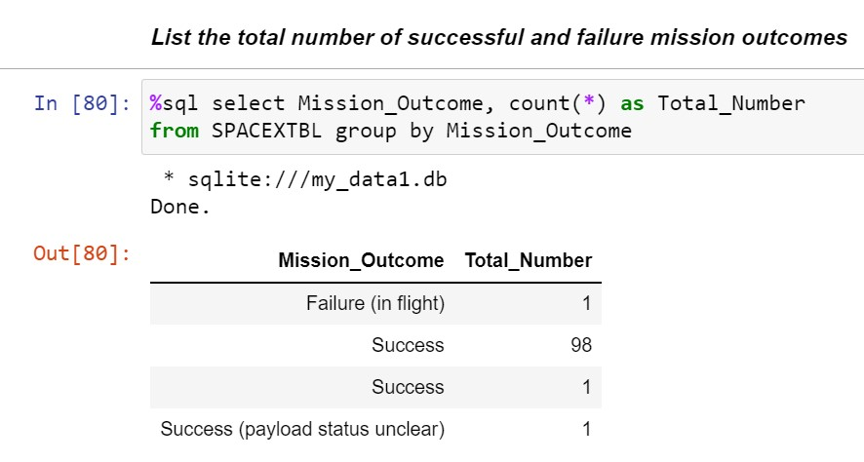
Total Number of Successful and Failure Mission Outcomes
We have 99 Successes and 1 Failure.
We use the count function with the group by to count how many success values and Failures we have, and we used group by to group the outcome into two classes success and Failure, and we store the counted values in new columns called Total_Number.

Slide 32
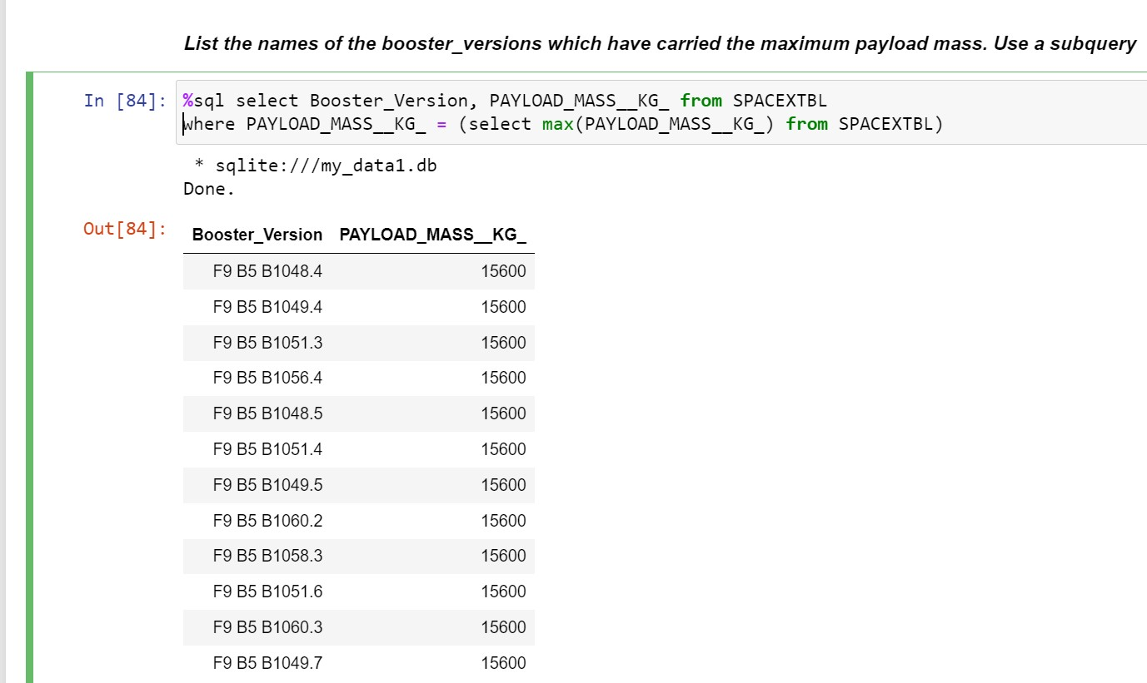
Boosters Carried Maximum Payload
We used a subquery to review the result.
We show the Booster_Version, Payload_Mass_KG, and our where clause contained a subquery for getting the maximum Payload_Mass_KG.

Slide 33

Section 3

Slide 34
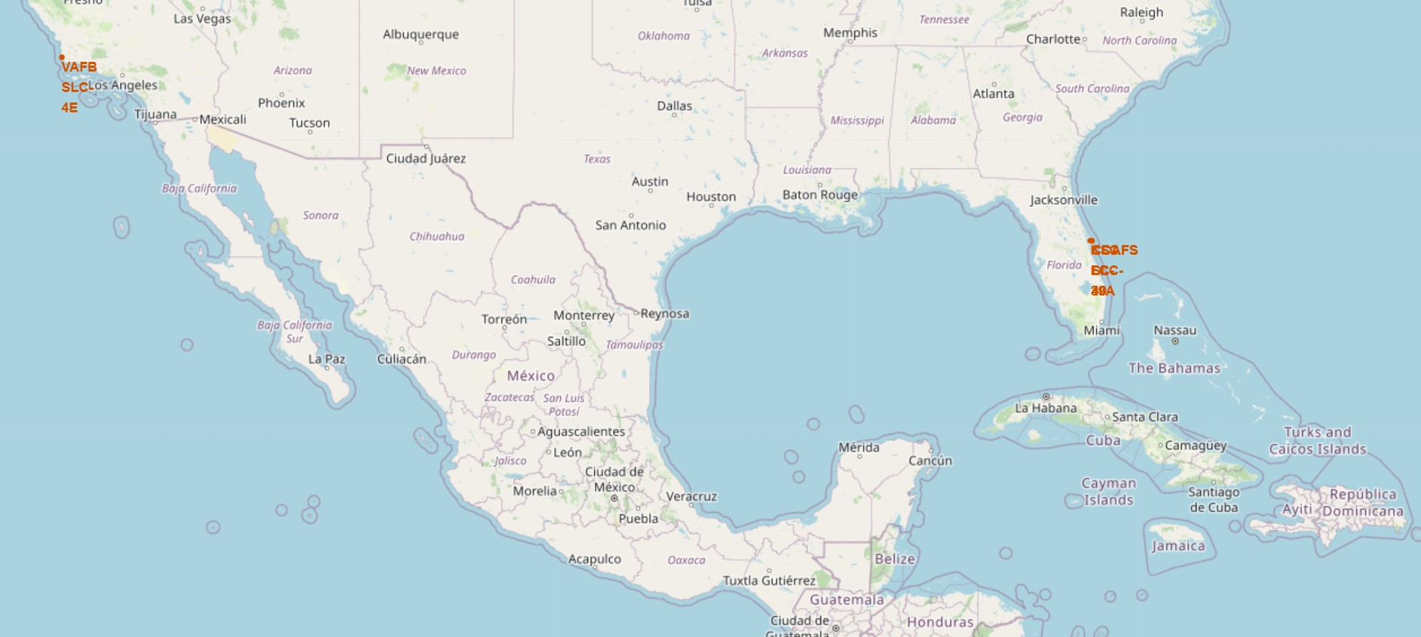
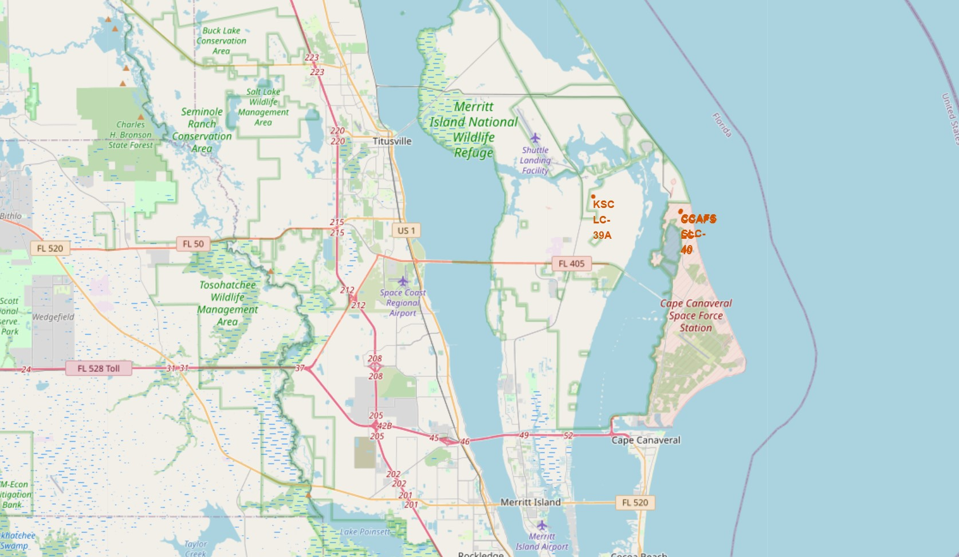
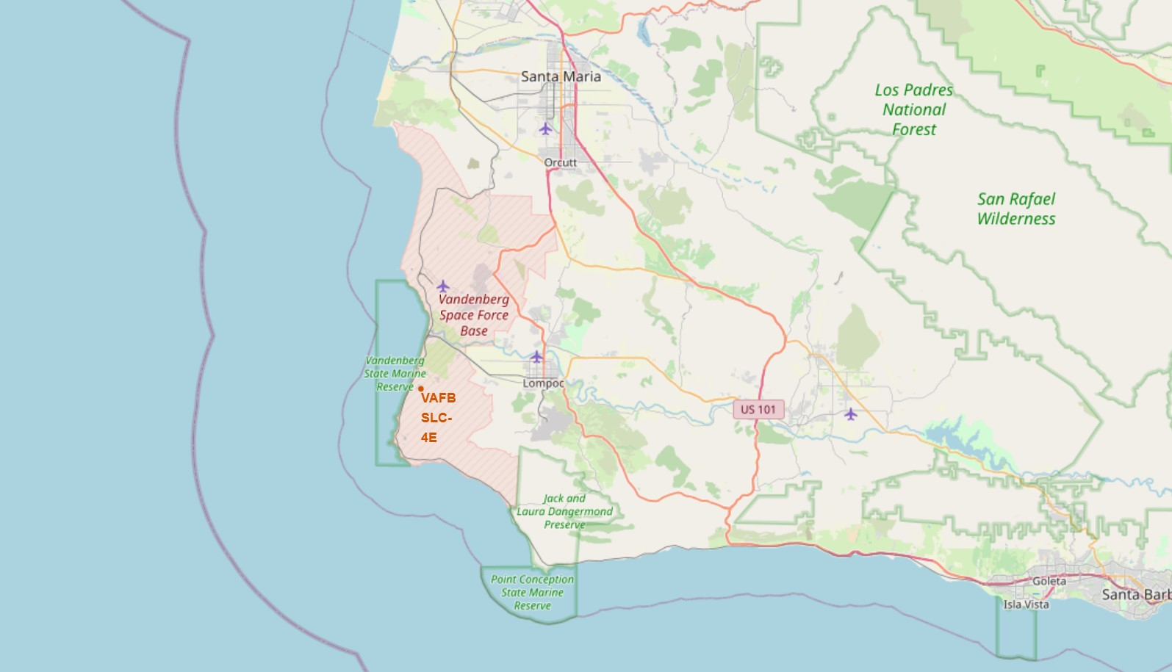
Launching Sites Locations
The first photo on the left shows the site for each launching site.
The right two photos show the location for each two nearest launching sites.
The top right photo shows the two Florida launching sites that are very close to each other, and the bottom photo shows the Los Angles two launching sites that are close to each other too.

Slide 35
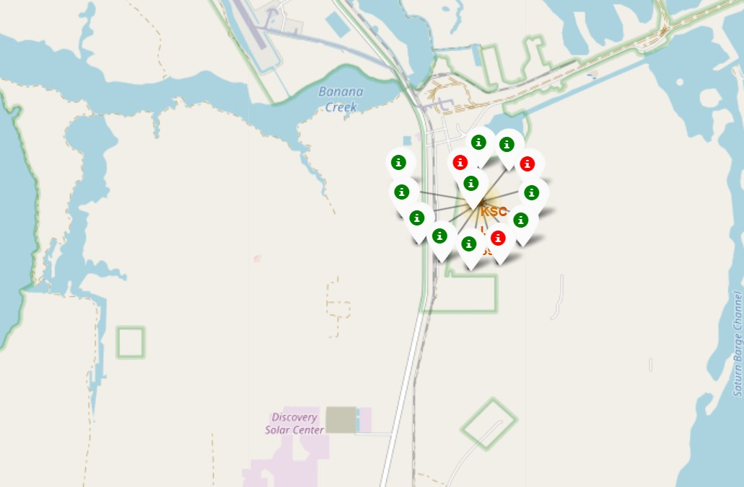
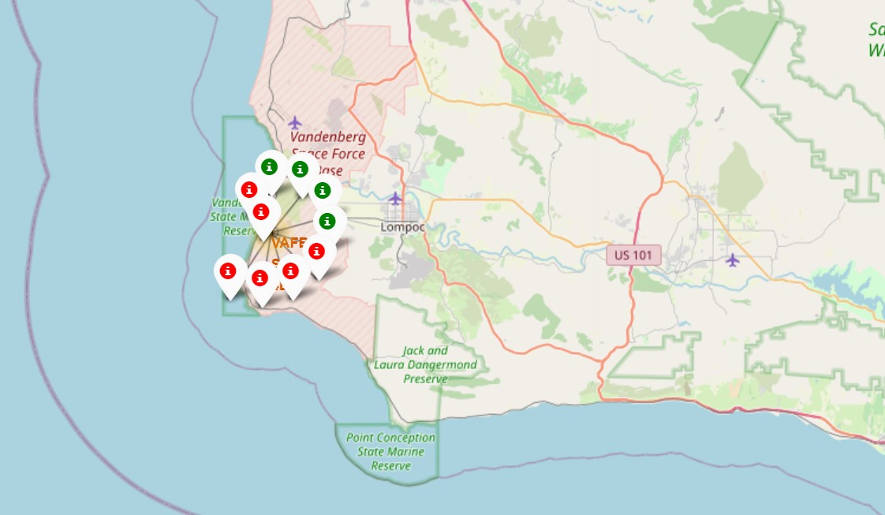
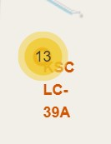
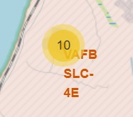
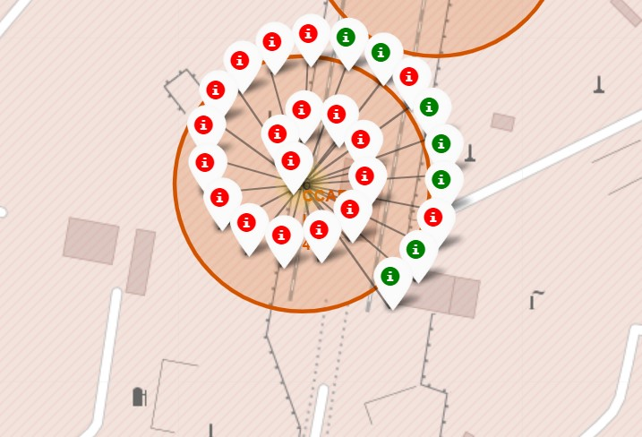
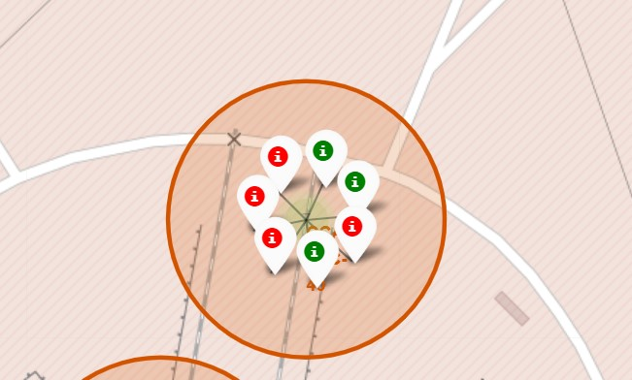
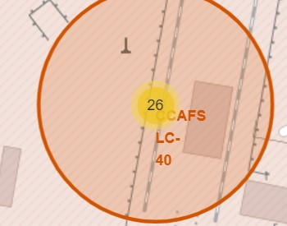
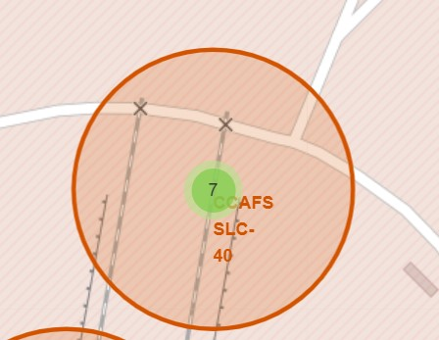
Total number of lunching with success or failed status
In the photos we show the failed launching with red dots and the successful launching with green dots, for every launching site.
The yellow area with the number, this number represents the total number of launches for every area.

Slide 36
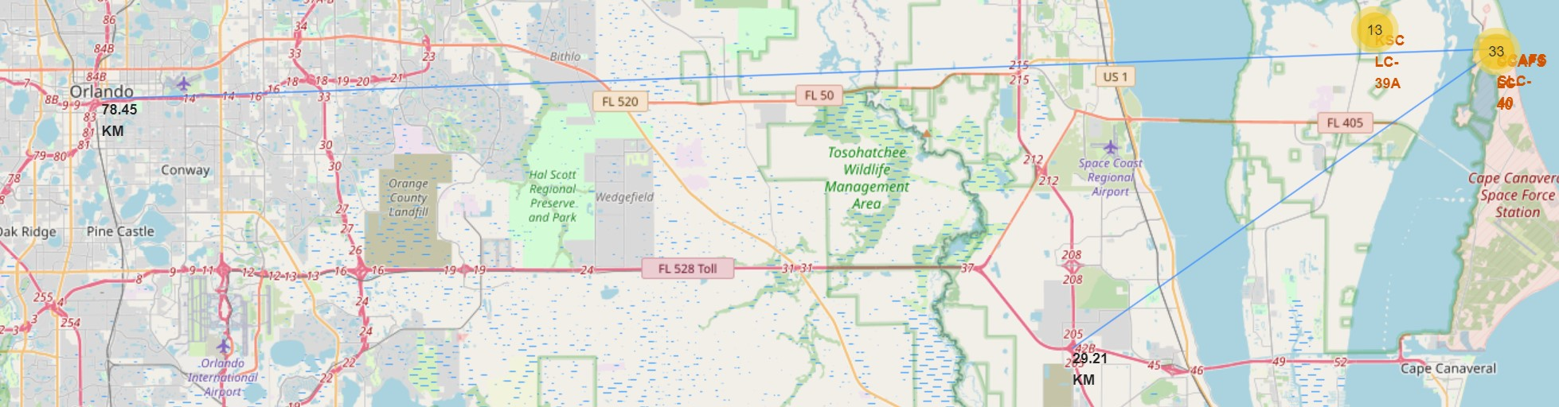
<Folium Map Screenshot 3>
The two photos indicate the distance between the launching site and the nearest highway.
From CCAFS SLC-40 to Beach Expression Way 29.21 KM
From CCAFS SLC-40 to South Street 78.45 KM

Slide 37

Section 4

Slide 38
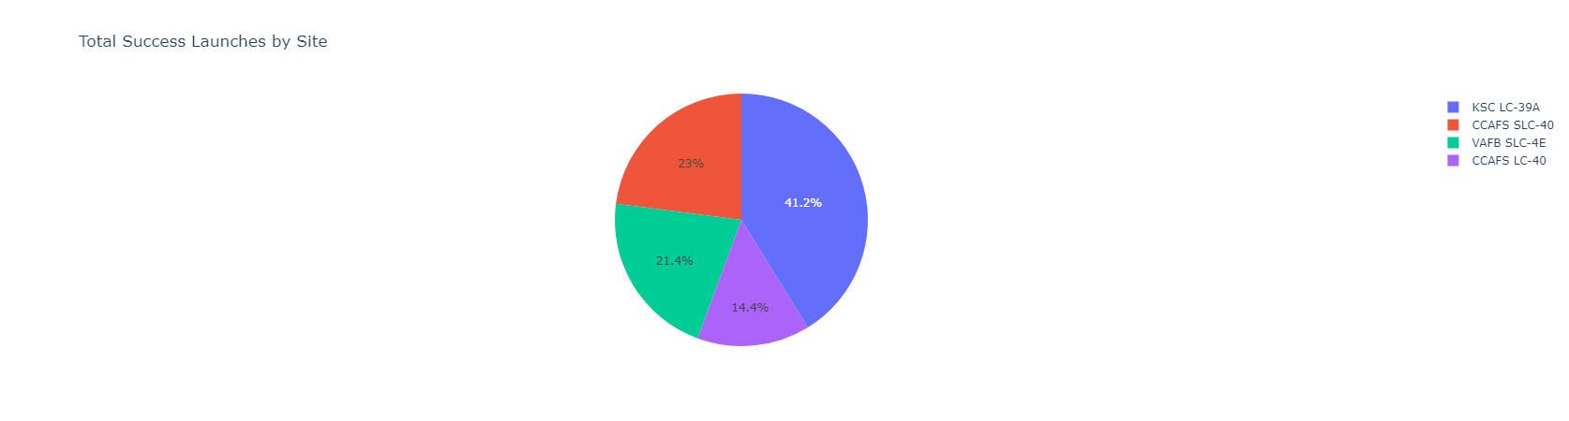
Total Success Landing Across Lunching Site
This Pi chart review the total Success Landing for every launching site.
KSC has the greatest amount of successful landings, in the second place CCAFS SLC-40.
VAFB SLC-4E(21%), and CCAFS LC-40(23%) have the smallest amount of success.

Slide 39
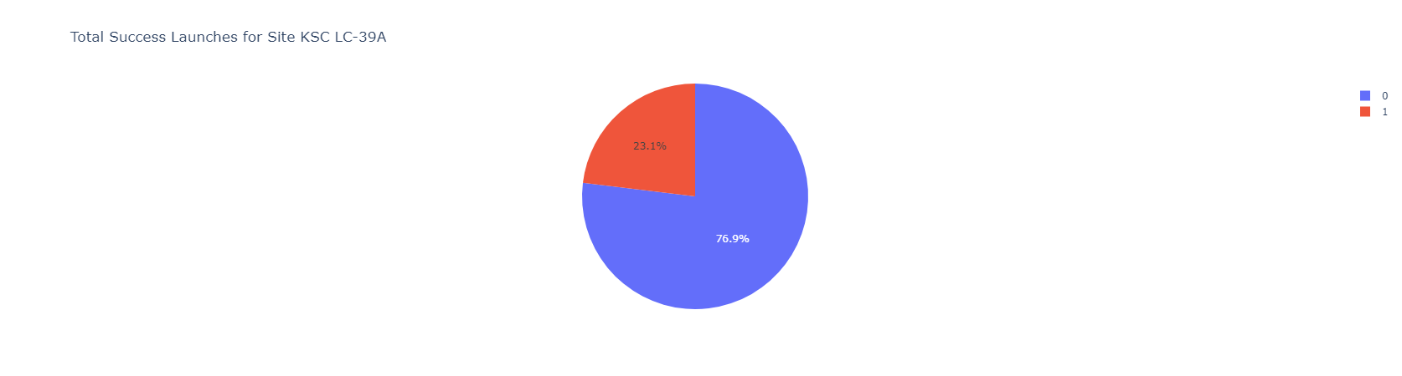
The Highest Success Launching Site
Pi chart review the highest success launching site KSC LC-39A.
1 viewed in blue color which indicates the success of landing, the success rate is 76.9, and 0 indicates the landing failed, the failure rate is 23.1%.

Slide 40
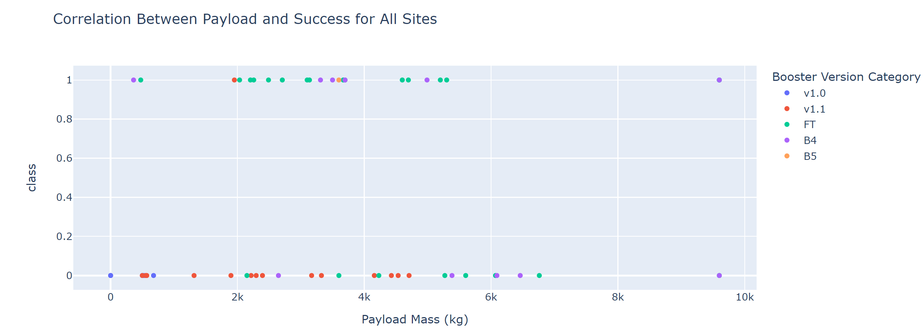
<Dashboard Screenshot 3>
This plot shows the success and faille of every booster with a different color.
success landing take class 1 and faille 0, and every booster have a different amount of load (KG).

Slide 41

Section 5

Slide 42
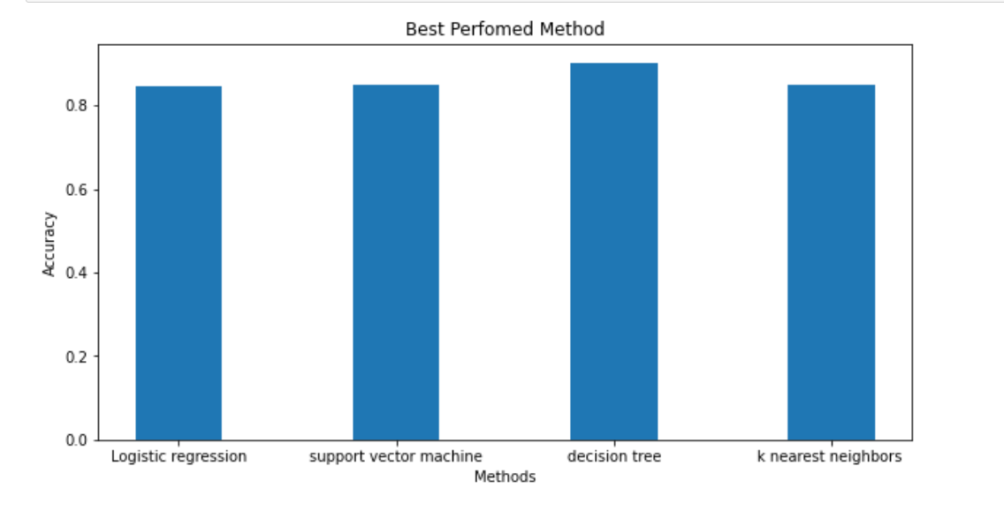
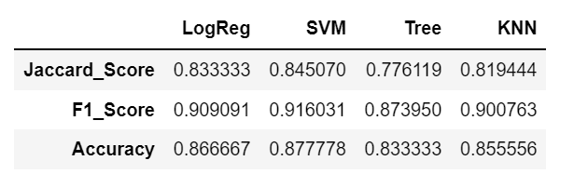
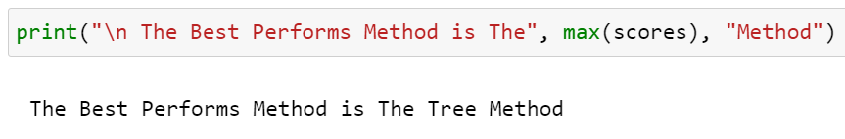
Classification Accuracy
The bar chart displayed the accuracy for every model that we build.
We can see that the Decision Tree model gets the best performance.

Slide 43
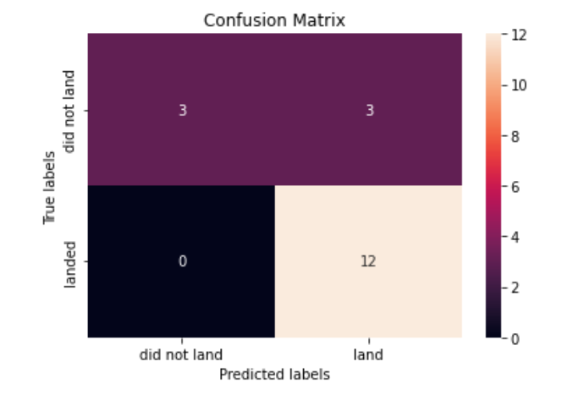
Confusion Matrix
All the models have the same Convention Matrix because they give the same result with the test data.
The model Predict 12 successful landings while it was labeled as landing.
Predicts 3 unsuccessful landings while it’s labeled unsuccessful landing.
Predicts 3 successful landings while it’s labeled unsuccessful landing.

Slide 44
Conclusions
Our task: to develop a machine learning model for Space Y which wants to bid against SpaceX
The goal of the model is to predict when Stage 1 will successfully land to save ~$100 million USD
Used data from a public SpaceX API and web scraping SpaceX Wikipedia page
Created data labels and stored data into a DB2 SQL database
Created a dashboard for visualization
We created a machine learning model with an accuracy of 83%
Allon Mask of SpaceY can use this model to predict with relatively high accuracy whether a launch will have a successful Stage 1 landing before launch to determine whether the launch should be made or not
If possible more data should be collected to better determine the best machine learning model and improve accuracy

Slide 45


